Slide 1

Web _ based Live Translation
Assistant
Eng: Walaa Zaghloul
Supervised by Dr: Ashraf Fahmy

Slide 2
prepared by
Muhammad Shaaban Muhammad Owais
Mina Atef Thabet Ibrahim
Mina Mahrous Gad Al-Sayyid Daoud
Mina Milad Shohdi Ibrahim
Hana Salib Youssef Salib

Slide 3
Table of content
Introduction.
Analysis And Design.
Background.
Technology.
Future Works.

Slide 4
overview
The project is a video conference platform with live audio translation.
Users Can communicate by video calls and text chat.
Offers an instant auto translation.
Supports multiple languages.
Offers an audio multi-language chatbot.

Slide 5
Problem statement
Most people can’t speak multiple language
Video conference platforms don’t support live audio translation.
Manual translation takes too much time.
People with sight disability can’t engage in communication.
limit information exchange.

Slide 6
who is effected by this problem ?
Businesses
Professionals
Education
Family And Friends

Slide 7
Objectives
Designing a user-friendly platform that provides video and chat conferencing communication.
Implement real-time translation in multiple languages.
Provide a wide range of languages and dialects.
Ensuring users security.
Design an audio multi-language chatbot.

Slide 8

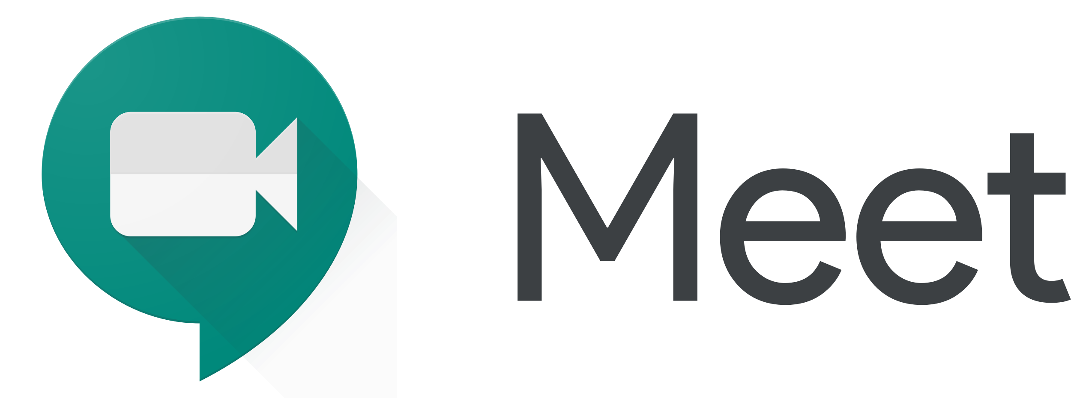

Related works
The field of video conferencing has many platforms offering real-time communication.

Slide 9
Related works
However, none of them has the functionality of translating spoken language in real-time.
The project solve this limitations by integrating a live audio translation technology.

Slide 10
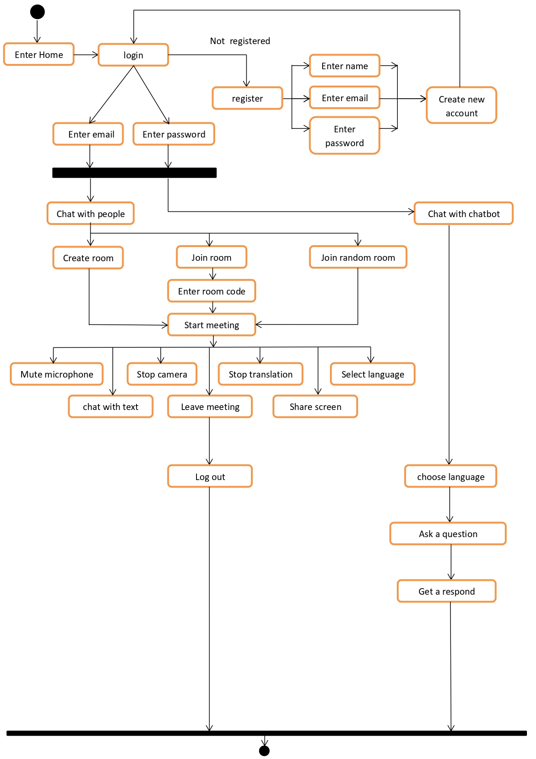
activity diagram

Slide 11
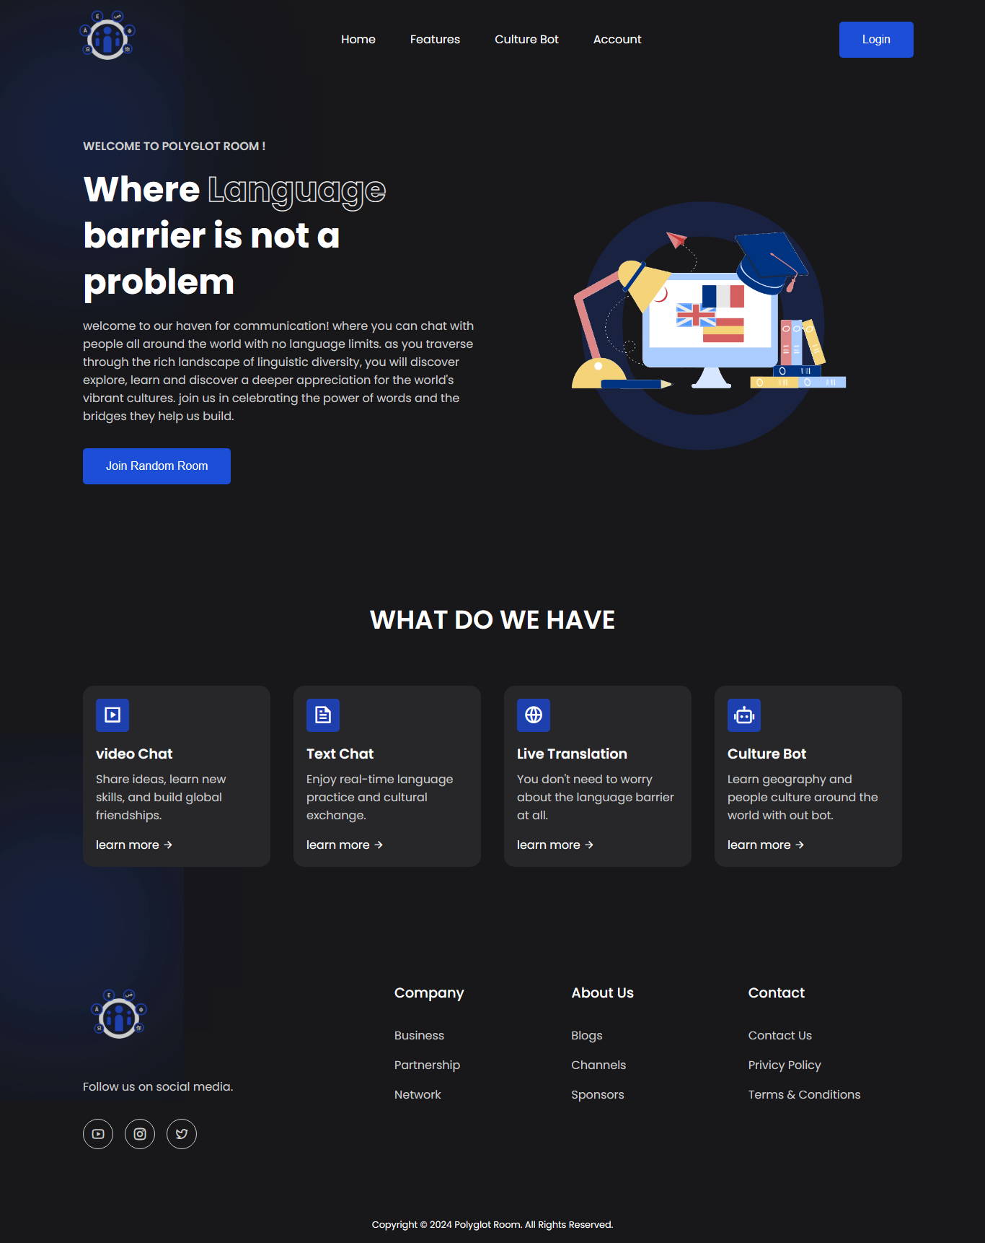
design
Home Screen

Slide 12
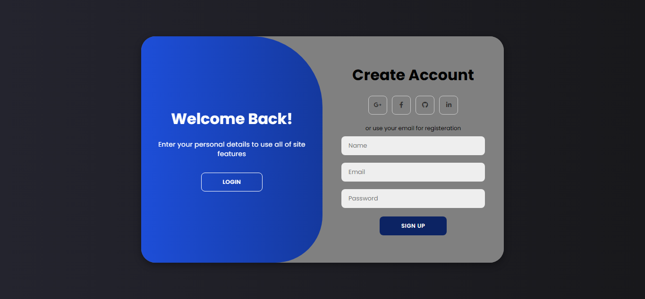
design
Register Screen

Slide 13
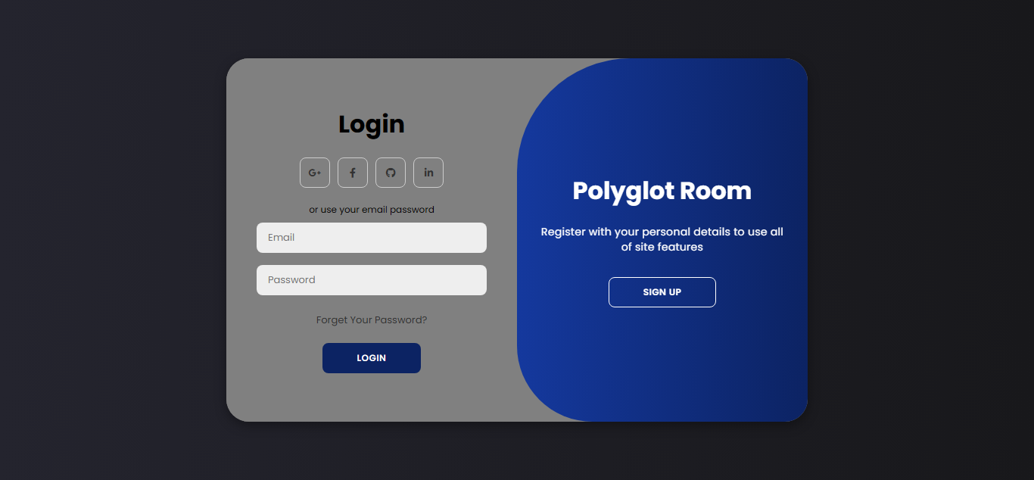
design
Login Screen

Slide 14
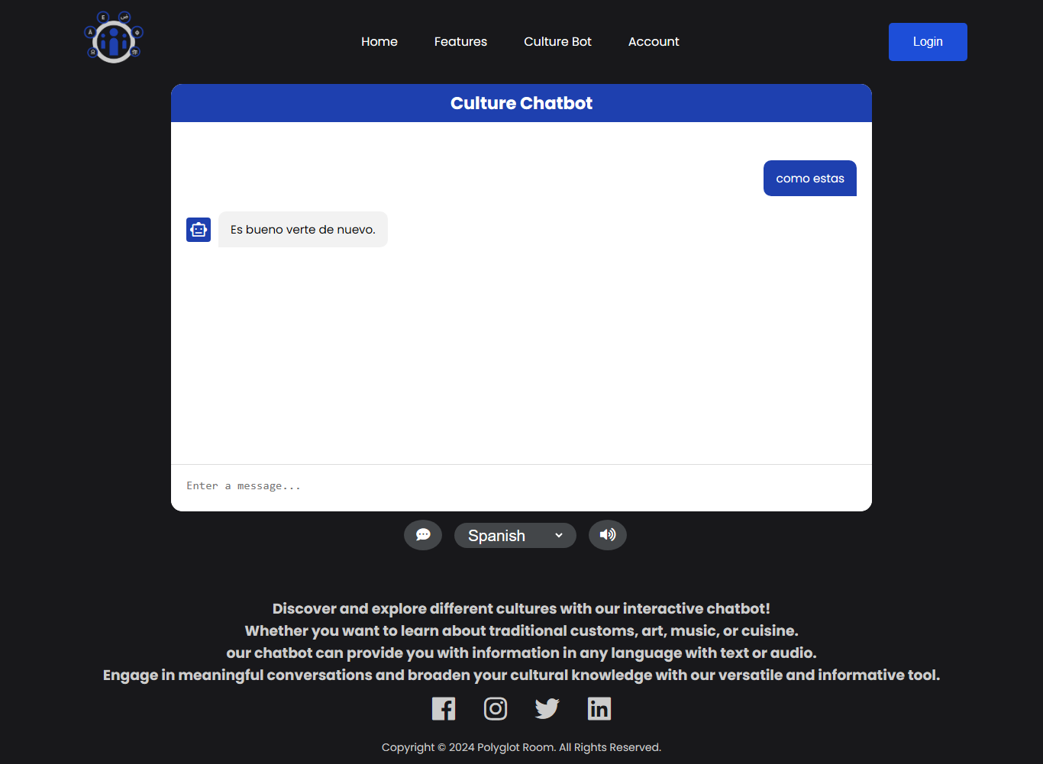
design
Chatbot Screen

Slide 15
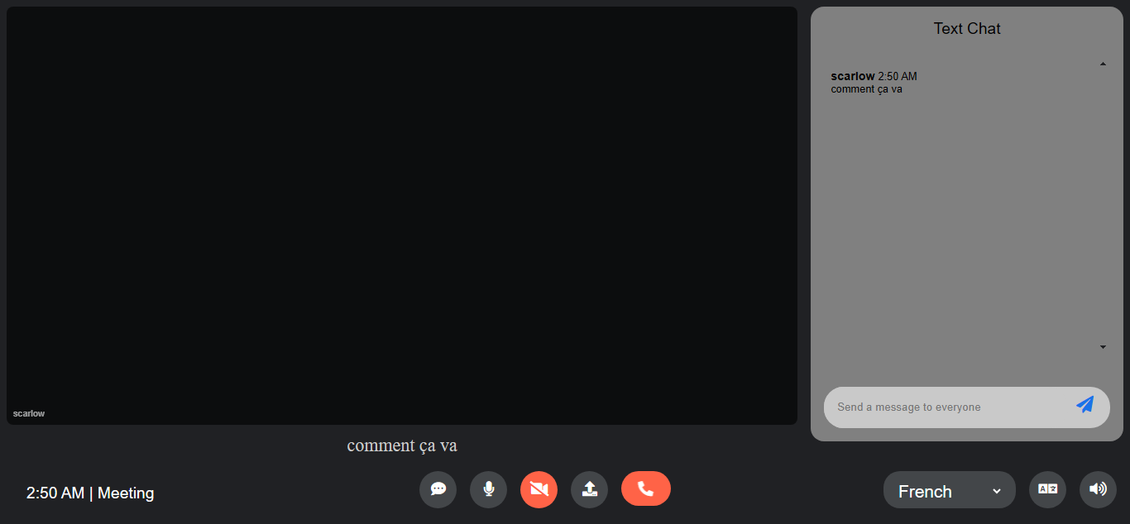
design
Room Screen

Slide 16



Background
1- Frontend
HTML for website structure.
CSS for styling.
JAVASCRIPT for implementing functionality.

Slide 17



Background
2- Backend
Node.js for running JavaScript on the server-side.
Express.js for routing and http request handling.
EJS for rendering html templates.

Slide 18

Background
3- Database
Firebase for users authentication, login and
saving users data.

Slide 19



Background
4- AI
PyTorch for creating the chat bot model.
Python for the chat bot training and development.
Flask for backend to connect the chat bot to the website.

Slide 20

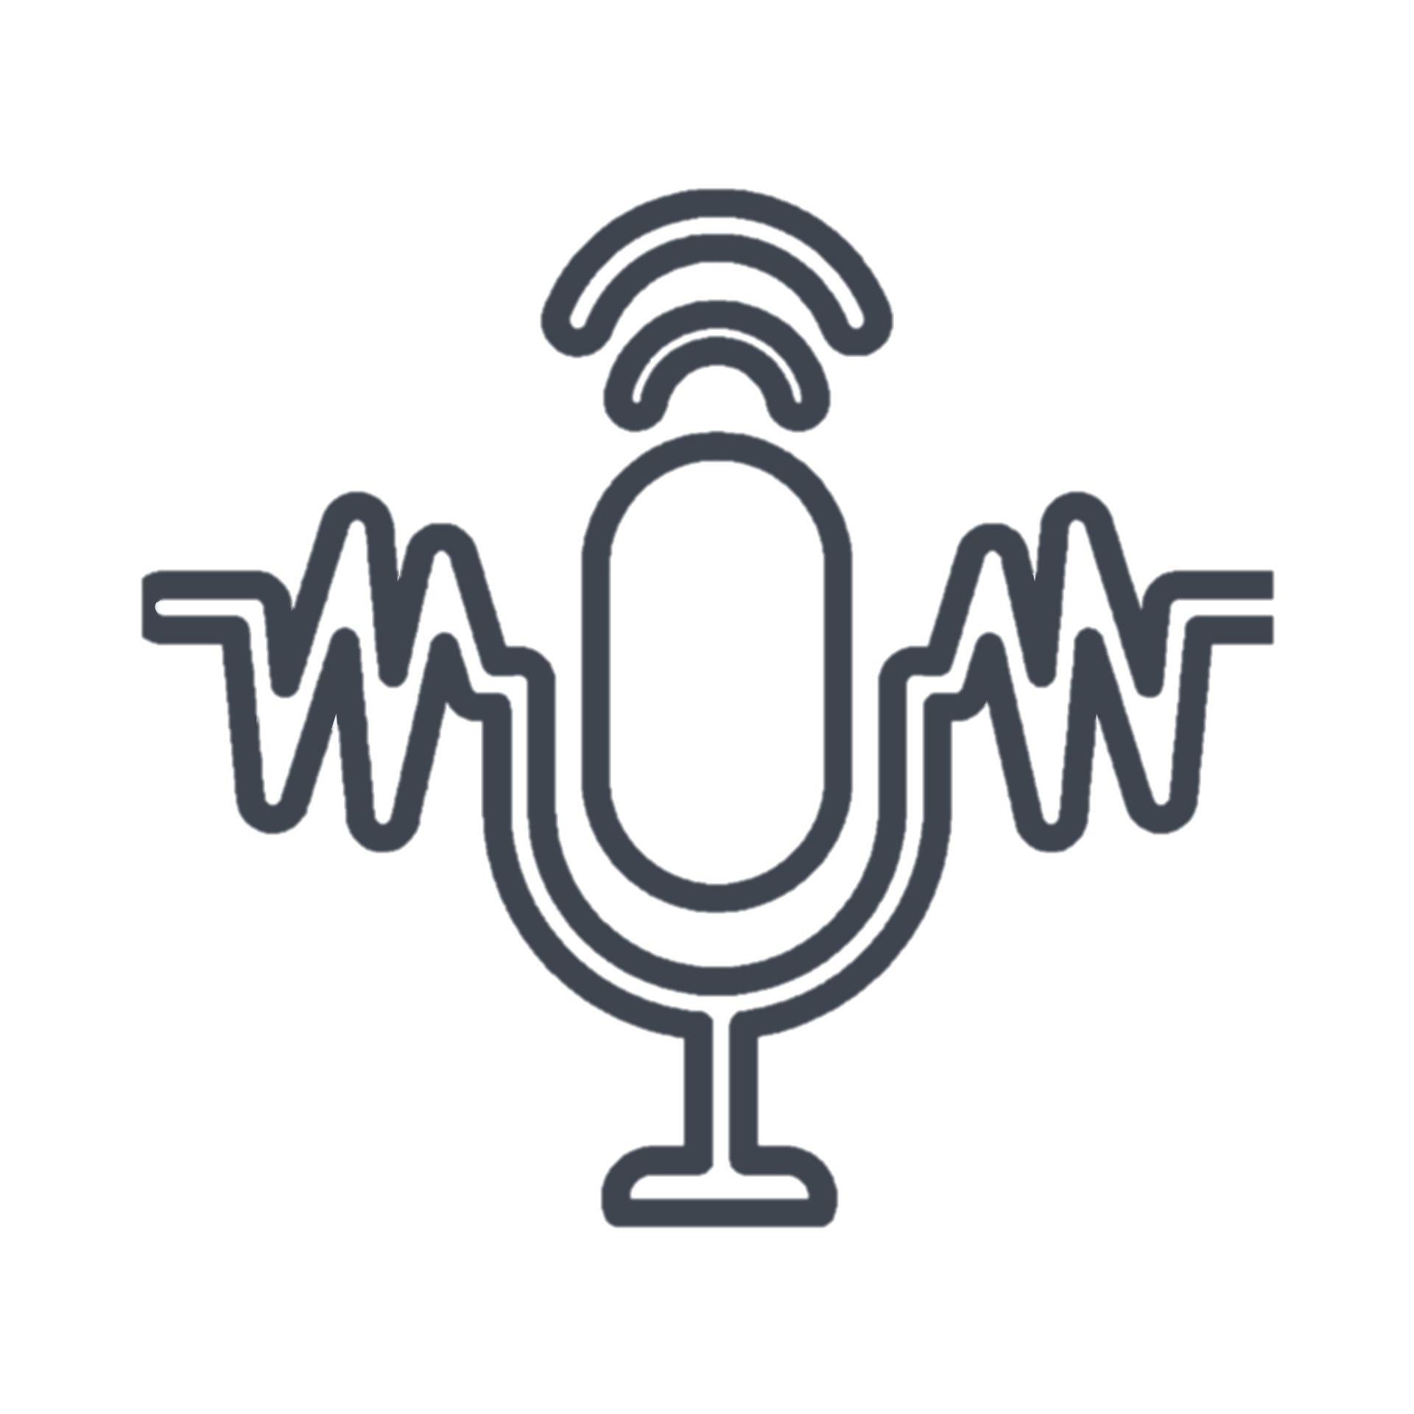
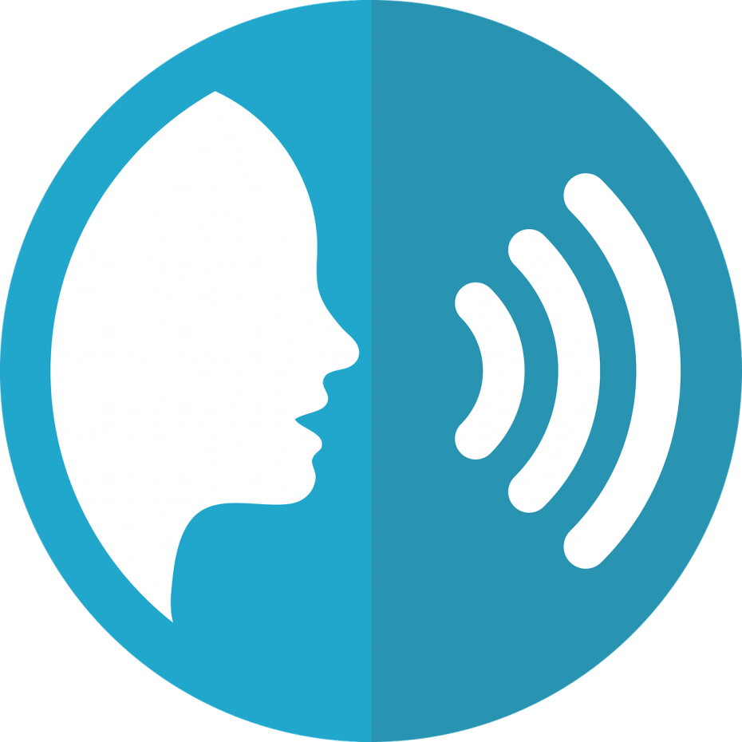


Used Technology
Web RTC
Speech recognition
Text to speech
Translation
NLP

Slide 21
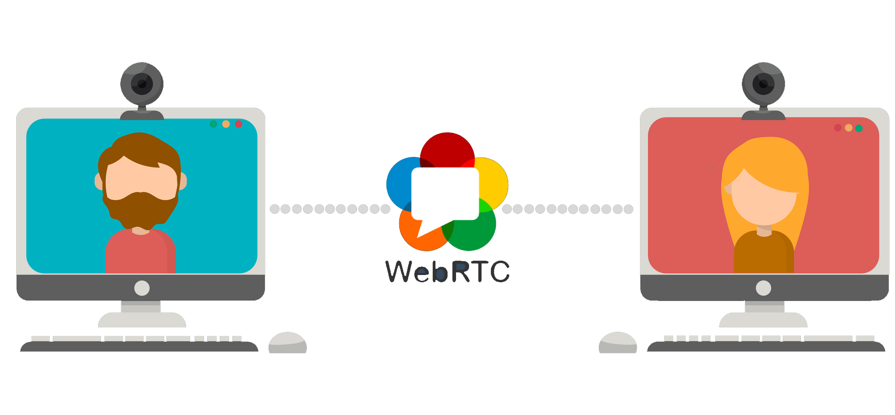
What is Web RTC ?
Stands for web real time communication.
Enables Peer-to-peer communication between devices
Provides voice calling, video chat, and file sharing.
Uses secure encryption methods for data and media transmission.

Slide 22
How Web RTC works
Signaling
Exchange information such as network addresses and other details.
Peer Connection
Two devices establish a direct peer-to-peer connection without a server.
Media Stream
Exchange video and audio streams and other data over the peer connection.

Slide 23



How Web RTC works
Signaling
Connection
Streaming

Slide 24
Web RTC vs web sockets
Web Socket
Web RTC

Slide 25



What is Speech recognition ?
Computer ability to interpret spoken language.
Enables devices to understand human speech by turning it into text.
Allows users to interact with applications through voice input.
Useful for users with disabilities.

Slide 26
How speech recognition works
Signal Processing
Remove background noise and break audio down into smaller parts.
Feature Extraction
Important features such as frequency, pitch, and durations of speech
Decoding
Compare input to a large database of words and phrases.

Slide 27

What is Text to speech ?
Converts written text into spoken words.
Allows devices to read text and generate realistic human-like voice.
Useful for users with visual disability.

Slide 28

How TTS works
Combines sound from a pre-recorded database to represent words and phrases

Slide 29
TTs applications
Customer service
Virtual assistants
Content creation
Smart devices
Games

Slide 30
Translation
Converting text from one language to another.
Use artificial intelligence and natural language processing to translate text.

Slide 31
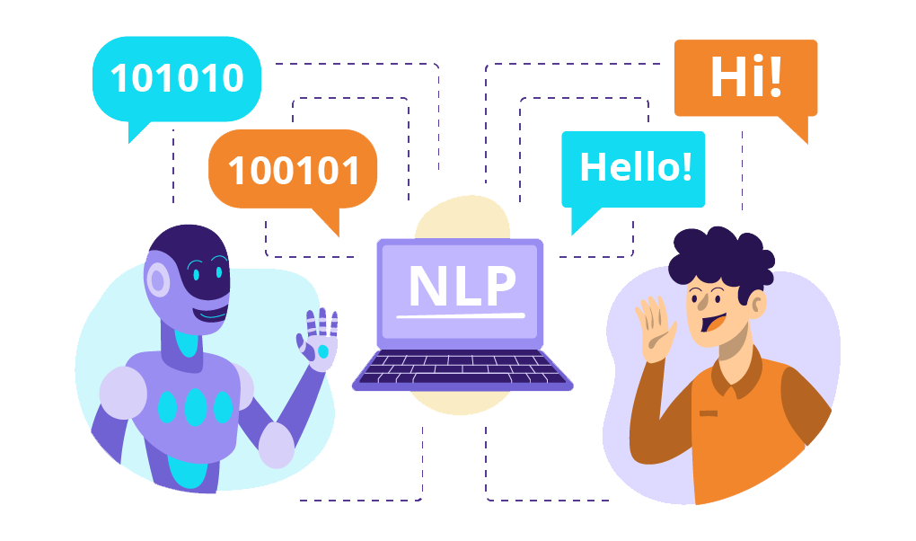
What is nlp ?
Stands for natural language processing.
Branch of artificial intelligence
Focuses on the interaction between computers and human language.
Enables computers to understand, interpret, and respond to languages

Slide 32
Data pre-processing in nlp
“Natural language processing is a fascinating field of study. It involves analyzing and understanding human language.”
1
[
“Natural language processing is fascinating field of study.",
"It involves analyzing and undersatanding human language.“
]
Segmentation

Slide 33
Data pre-processing in nlp
“Natural language processing is a fascinating field of study.”
2
[
"Natural", "language", "processing", "is", "a", "fascinating", "field", "of", "study“
]
Tokenization

Slide 34
Data pre-processing in nlp
["Natural", "language", "processing", "is", "a", "fascinating", "field", "of", "study"]
3
[
"Natural", "language", "processing", "fascinating", “field", "study“
]
Stopword Removal

Slide 35
Data pre-processing in nlp
["Natural", "language", "processing", "fascinating", "field“, "study"]
4
[
"natur", "languag", "process", "fascin", "field", "studi“
]
Stemming

Slide 36
Data pre-processing in nlp
“Computer was invented in England.”
5
Noun Verb Verb Preposition Noun
Part of speech tagging

Slide 37
Data pre-processing in nlp
“Steve jobs released Apple in 1976 in USA."
6
Person Organization Country
Named entity tagging

Slide 38
Applications of nlp
Translation
Smart assistants
Chatbots
Search engines
Auto correct
Text analysis
Email filtering
Speech recognition

Slide 39
How the communication process occurs
User speaking
Turning voice into text
Sending message to other user
Translating to selected language
Turning text into voice
Other user listening

Slide 40
Future works
Multi-platform Support
Voice Changing Functionality
Improved Translation Technology
Expand supported platforms like desktop computers and mobile devices.
Users shall hear other person translated voice.
Enhance accuracy, speed and adding support for dialects.

Slide 41
Thank You

